Slide 1


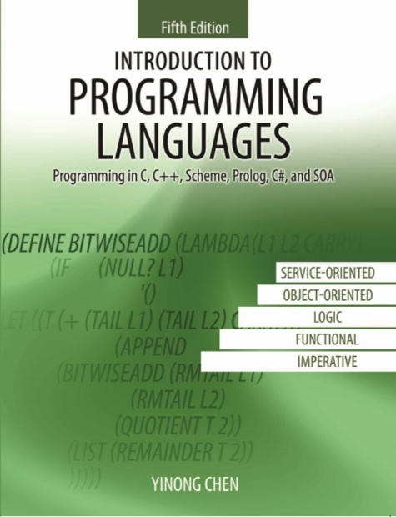
CSE240
Introduction to Programming Languages
Chapter 1
Common Aspects of Programming
Languages
Lecture 02
Computing Paradigms
Reading: Textbook Section 1.1
Yinong Chen

Slide 2
Common Aspects of Programming Languages
There are about several thousand programming languages in use.
How do we learn programming languages?
Learn all or as many as possible
Learn the most popular ones
Learn the concepts and paradigms
Learn a representative in each paradigm
Syntax definition
Compiler
Library
Why do we learn concepts and paradigms?
Increased capacity of expressing ideas
improved background for choosing appropriate languages
increased ability of learning new languages
increased ability of designing new languages
better command of languages

Slide 3
Aspects of Programming Languages
What criteria (metrics) do we use to evaluate programming languages?
Reliability
Readability
Writability
Reusability
Efficiency
Importance depending on where you use the language.
A typical choice is: decreasing importance
However, if you are developing a real-time system and have to beat the deadline, you may have to put efficiency as the most important one.

Slide 4
Aspects of Programming Languages
What characteristics of a language improve what performance metrics of the program written in this language?
Performance metrics
Execution Readability Writability Reliability
efficiency Reusability
Characteristics
Simplicity/orthogonality • • • •
Control structures • • • •
Data types & structures • • • •
Syntax design • • •
Support for abstraction • • •
Expressivity • •
Strong/weak type checking •
Exception handling •
Restricted aliasing/pointer •

Slide 5
Development of Programming Languages
has been influenced by
Development of hardware --- early emphasis on execution efficiency;
Development of compiler technology;
Need for and ability to write larger programs:
Code reuse;
Component reuse;
System reuse
Facilitating the discovery of reusable code
Trustworthiness of the reused code
Web enabled sharing
…

Slide 6
Development of Programming Languages (Contd.)
Stored Program Concept (von Neumann machine)
The concept was developed in the late 1940s. It’s still the most popular model of computing:
A program is a sequence of instructions stored in memory.
The CPU interprets the program in the specified order.
At the lowest level, the program is a sequence of bits (binary number) of machine code. Data are also stored in binary.
Next step: use of mnemonics (certain symbols), allowing programs to become more sophisticated (assembly language, e.g., bytecode for Java, Intel assembly, and MIPS):
1. simple variables
2. conditional assembly
3. macros, relative addressing
Requires a program (assembler) to translate to machine code in order to execute. Still very low level.

Slide 7
Development of Programming Languages (Contd.)
As tasks got bigger and machines got more powerful, leading to
development of higher level programming languages.
Examples: Autocode, FORTRAN, COBOL, LISP, Scheme, C, ...
Autocode on Manchester Mark I, 1952:
First high level programming language
Single letter identifiers (26)
Simple formulas: a+b, c-d → 2*a+3*b*c-d
FORTRAN: IBM Mathematical FORmula TRANslating system
Variables of different types (real, integer, array);
Procedures
Conditional (if-then, no if-then-else)
Simple control structures
But still at quite low level; quite machine dependent.
There are difficult to understand features.
Characterized as spaghetti programming, or monolithic programming.

Slide 8
Development of Programming Languages (Contd.)
Emergence of structured programming: Algol, Pascal, C
The main ideas of structured programming are
More abstraction from the machine.
Focus on structure in the program — use of procedures
to divide the program into reasonable sized pieces,
not only as a way of code reuse.
Use of different scopes (i.e. local variables) encouraged.
Better support for procedures
Better data structures
Much better control and loop structures. “Goto” considered
harmful. "The quality of programmers is inversely proportional
to the density of go-to statements in their programs." Dijkstra.
Object-oriented programming
Abstraction/Encapsulation
Code reuse/inheritance
Simula, Smalltalk, Eiffel, C++, C#, Modula-3, Python, Java, etc.

Slide 9
Development of Programming Languages (Contd.)
Parallel and Distributed Computing and Programming
Parallel/Multithread programming: multiple tasks or threads running in parallel. Java, C#, Concurrent C, and C++. Textbook Section 3.7
Have a number of CPUs working on the same task (shared and distributed memory): CSP, occam, Linda, Emerald, Ravan, Core.
Service-Oriented Programming, based on OO, + Web tech
XML/XML Schema • WSDL • BPEL
RDF/RDFS • UDDI • Xlang
OWL • SOAP • WS-CDL
Textbook Chapter 6

Slide 10
ASU VIPLE http://www.public.asu.edu/~ychen10/
https://en.wikipedia.org/wiki/VIPLE
VIPLE is a programming language that supports the following paradigms
General-purpose control flow programming (imperative)
Service-oriented computing, supporting RESTful and WSDL services
Parallel / multithreading programming, with underlying threads safety
Event-driven programming, with built-in and custom events
Workflow and visual programming
IoT and Robotics programming
Syntax definition
Compiler
Library

Slide 11
Paradigms
Generally, paradigm means sample or example used in teaching;
In computer science definition: Paradigm is a coherent set of methods that have been found to be (more or less) effective in handling a given type of problem.
In programming language definition: Paradigm is the basic principles of how a computation or an algorithm is expressed.
Imperative/Procedural, e.g., Assembly, Fortran, Ada, Pascal, C,
Object-oriented: Smalltalk, Java, C++, Python, C#
Functional/Applicative: Scheme/LISP, ML, XQL, LINQ
Logic/Declarative: Prolog,
Service-oriented: in CSE 445 and 446 (basic part in CSE240 text Chapter 6)
Other paradigms: real-time, event-driven (ASU VIPLE), dataflow, etc.

Slide 12
The Four Major Paradigms
Imperative/Procedural: the fully specified and fully controlled manipulation of named data in a step-wise fashion.
Object-oriented: encapsulation of state of the program in objects, which can be accessed only through operations defined on them. Other features incl. inheritance and polymorphism
Functional/Applicative: Focus on higher level of abstraction (free from programming detail), simpler semantics, closer to mathematical functions and referential transparency (no side-effects).
Logic/Declarative: a program is a set of facts about objects, rules about objects, and defining and questioning relations between objects. The goal is to get rid of programming altogether.

Slide 13
The Fifth Paradigm, starting from 2000 Service-Oriented Computing Paradigm
Separation Publishing Open Standards
Loosely coupled Discovery Protocols
Directory services
UDDI / WSDL / SOAP
ebXML / CPP
Database /Ontology
White pages
Service brokers
Yellow pages
OO Programming
languages:
C++, C#
Java
Registry
Registry
Green pages
(3) Found
Internet
(1) Publishing
(2) Find
Application builders
Service providers
Computing service
development:
Visual Studio .Net
J2EE
(4) SOAP call
Applications
Class/Object
(5) Results
Application development platform
Specification language
Composition BPEL, WF, VIPLE
Code generation
Web and data service development
XML, WSDL, SOAP, HTTP,
CSE 445

Slide 14
Paradigms of Computing
Abstraction Level
Service-Oriented
Programming
C++, Java, C# BPEL, VIPLE
Logic
Programming
e.g. Prolog
Object-Oriented
Programming
e.g. C++, Java, C#
Functional
Programming
e.g. LISP/Scheme
Imperative/
Procedural
Programming
e.g. Fortran, C
50s
60s
70s
80s
90s
00s
10s
Time

Slide 15
Granularity of Abstraction: Imperative to Service-Oriented
Granularity Level
Service-Oriented
Programming
Programming-in-the-large
Component-Based
Programming
Object-Oriented
Programming
Structured
Programming
Imperative
Programming
50s
60s
70s
80s
90s
00s
10s
Time
Programming-in-the-small

Slide 16
Evolution and Paradigm Shift
Service-Oriented
Programming
Object-Oriented
Programming
Abstract data types
Encapsulation
Inheritance
Dynamic binding
Autonomous services
Remote objects
Component-based composition
Remote invocation and binding
Separation of development
Open standards and protocols
Platform-independent
Repository of reusable services
Automatic discovering and binding
Collaboration negotiation
Dynamic reconfiguration
Functional
Programming
Stateless
Side-effect free
Enforced modular design
Logic
Programming
Database
Relations
Query and matching
Reasoning

Slide 17

WEB-based Computing: Web 2.0, Web 3.0, and Cloud Computing
Dynamic
SOC-based Web 2.0
UDDI, WSDL, SOAP
WWW (Web 1.0)
URI, HTML, HTTP
Semantics-based
Web 3.0
RDF, RDFS, OWL
Static
Syntax
Semantics

Slide 18
The Structure of Programs
How do we express programs, and what do they mean?
Different levels of analyses:
lexical:
begin … end, { ... }, ;
syntactic:
if … then … else …, switch, for ... do
contextual:
variable, type, name, initialization, etc.
semantic:
meaning and behavior of a program

